Slide 1
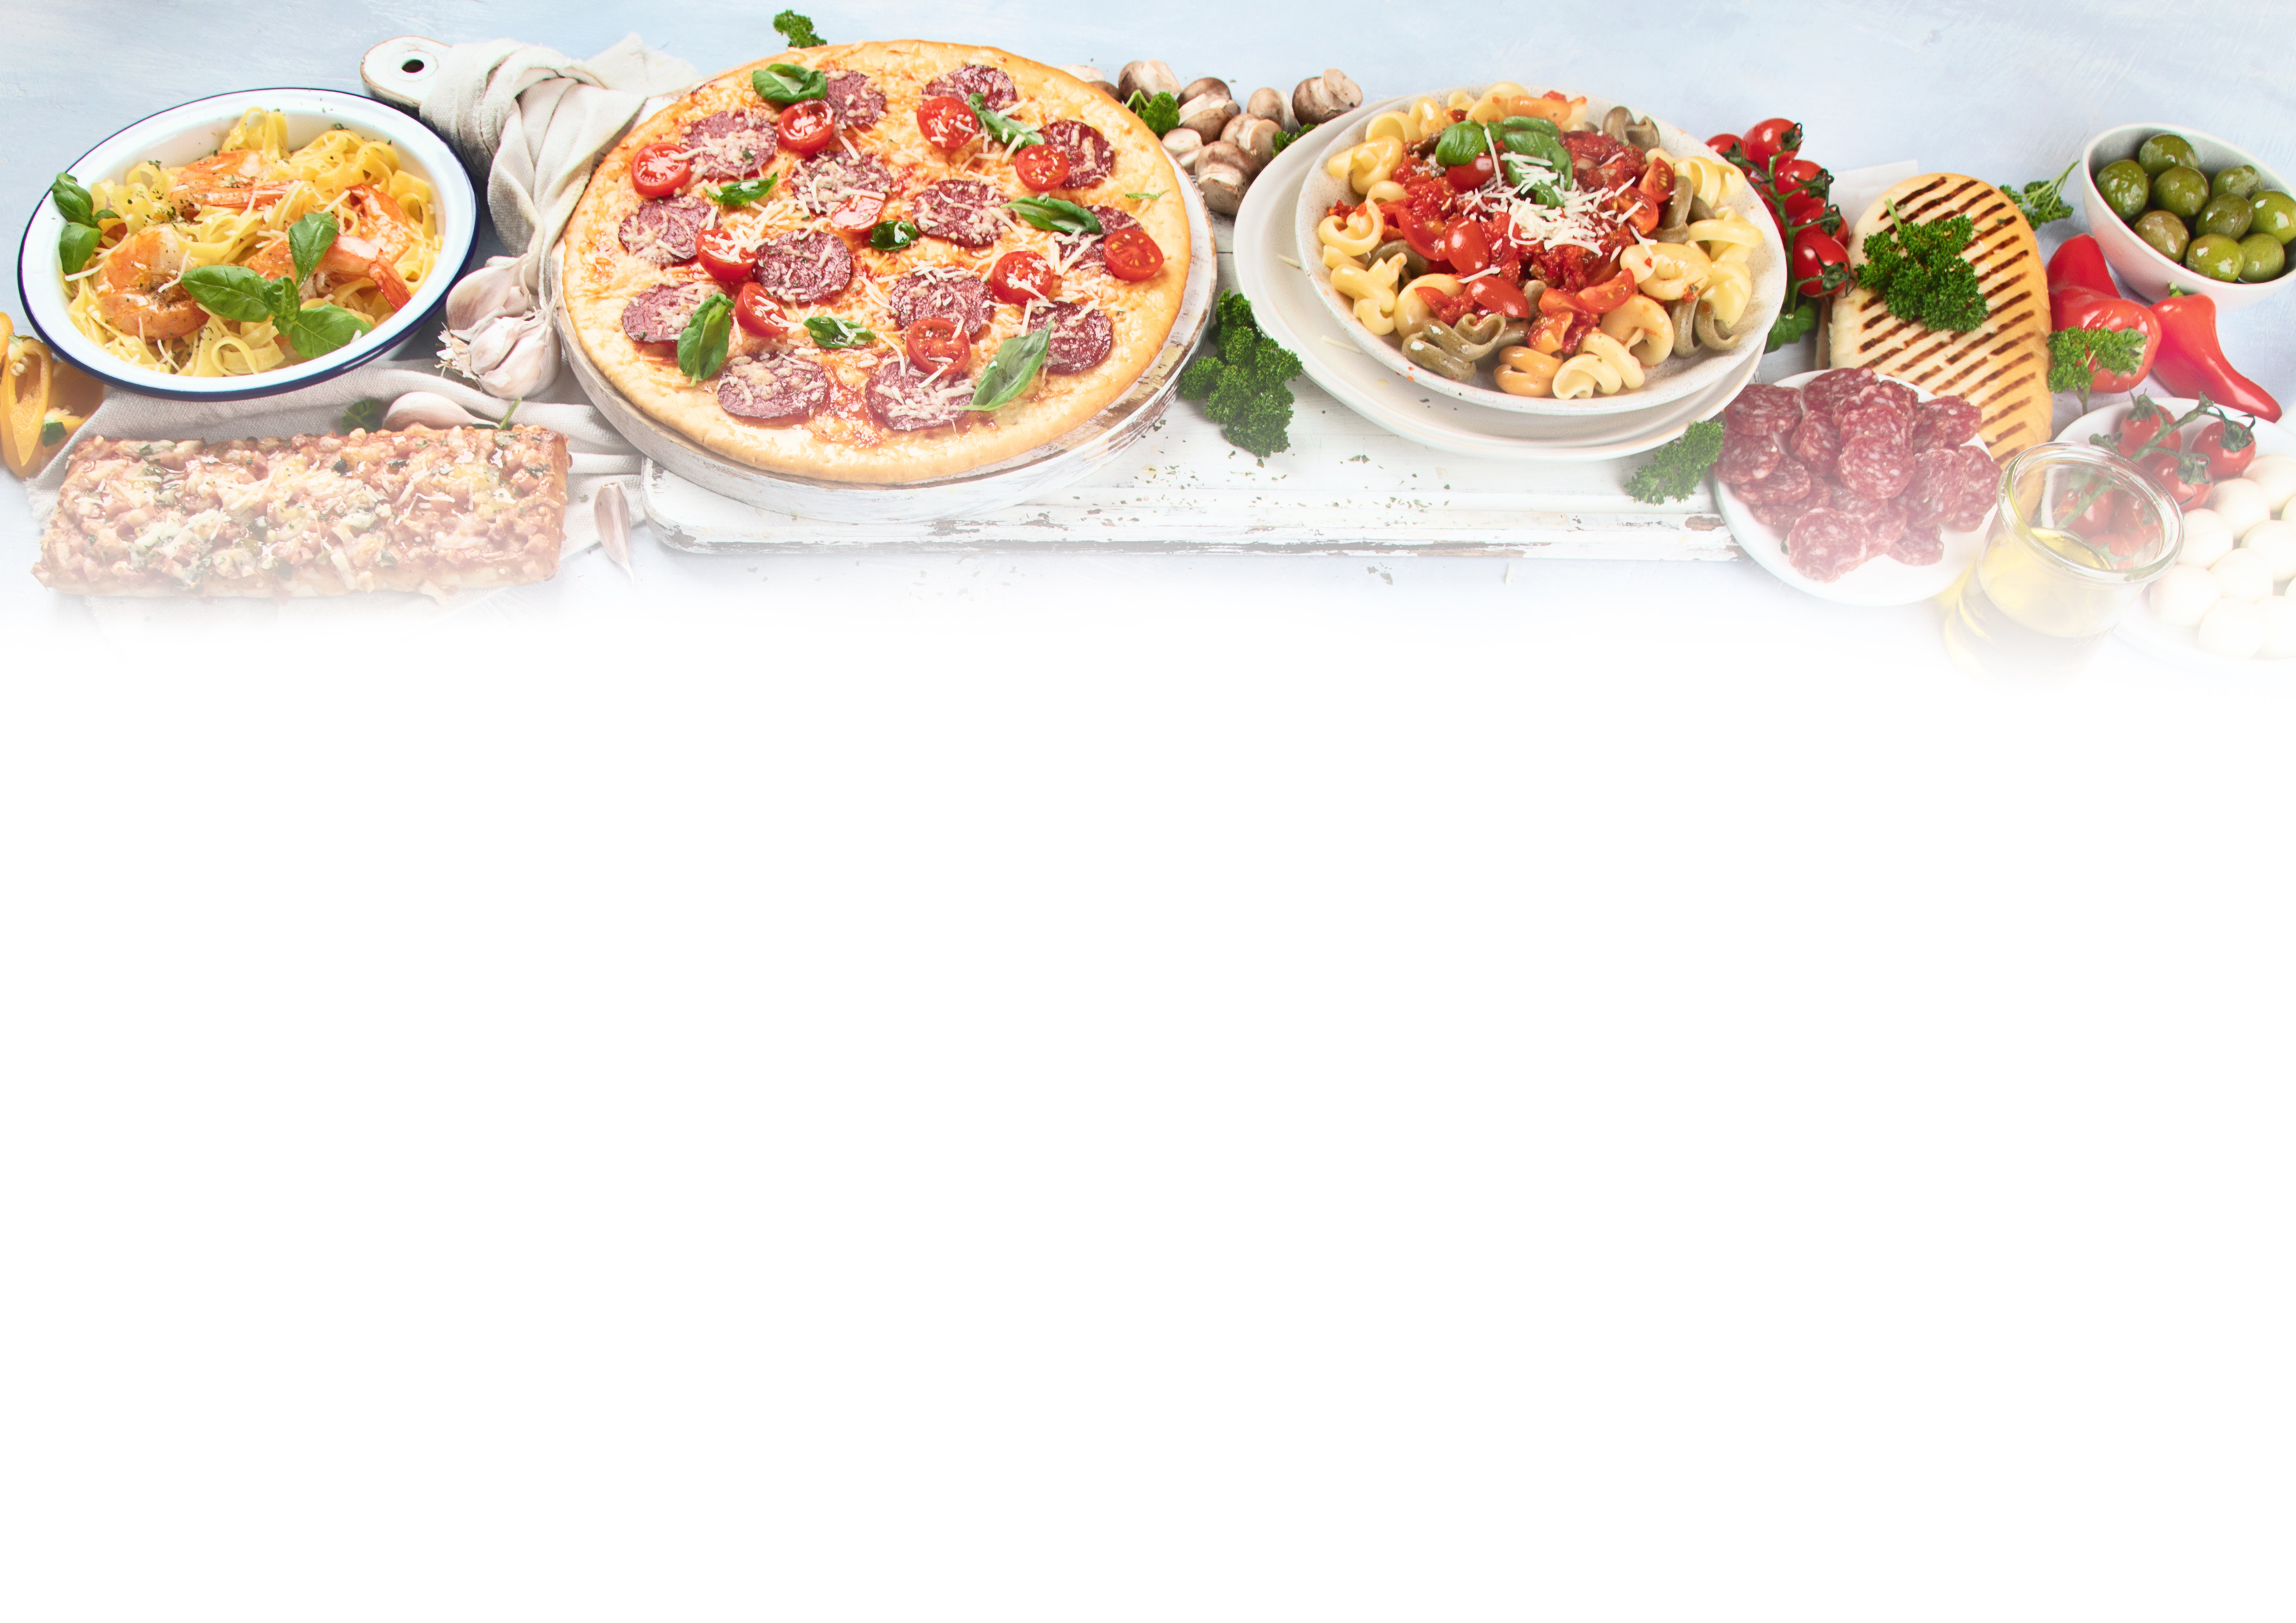
Making the most of your membership

Slide 2
Who we are
As the trade body representing the interests of the UK pizza pasta & Italian food Industry, PAPA provides a unique opportunity for suppliers to this £4 billion market to both demonstrate their support for the sector and reach potential customers.

Slide 3
What we do
Our members range from leading manufacturers of retail products to restaurants and delivery operators across all part of the UK. As a Supplier Partner we can help you reach this important market and in return you will be helping us look after the interests of the sector.

Slide 4
Nine reasons to join
Have access to industry advice
Take part in exclusive member meetings from time to time
Take part in technical sessions that shape industry best practice
Save money when attending the PAPA Awards
Join operators for regular on-line meetings related to the market
Opportunities for insights & networking
Have a profile of your business on the PAPA website which gets over 4000 unique visitors monthly
Be listed in Pizza & Pasta magazine as a Supplier Partner
Raise your profile and be seen to support the market

Slide 5
Boost your profile in the industry
As a Supplier Partner we will help you boost your profile in three key ways:
Upon joining, we’ll profile your business in in our bi-monthly magazine, Pizza Pasta & Italian Food which reaches over 5,000 decision makers across our industry.
Your business will be listed as a Supplier Partner in the dedicated supplier zone on our website, helping to connect you with those interested in sourcing your products. Over 4,000 people visit our website each month.
Your business will be listed in the product index of every issue of PAPA magazine for the duration of your membership.

Slide 6
Opportunities for insights and networking at member only briefing sessions
As a member we’ll provide you with opportunities to meet and network with potential customers at exclusive Association events, both online and face-to-face, where you’ll have the chance to learn about the latest industry trends and hear from industry leaders.
PAPA organizes regular online meetings for members as well as occasional face-to-face events when members can meet and network.

Slide 7
Be seen to be supporting your markets
As a Stakeholder, recognised by Government as representing the pizza, pasta and Italian food sector, we are there to represent the interests of all those operating in this £4 billion market, providing a voice both collectively and individually for all our members.
As a Supplier Partner you will be seen to be supporting the interests of the sector.

Slide 8
Stay informed and up to date about the issues that affect your customers
As the trade body representing the interests of the pizza, pasta & Italian food market in the UK, we provide a focal point for the industry, keeping operators up-to-date with legislation and, where appropriate, representing their interests to legislators and opinion formers.
As a Supplier Member we will also keep you up-to-date with what’s going on in the sector, from market developments to issues that are concerning operators.

Slide 9
Take part in industry meetings
As a Supplier Partner you will receive invitations to take part in activities being undertaken by PAPA, from technical meetings to exclusive member only briefings.
You will also have access to the resources of the Association for free advice.

Slide 10
What it costs
Supplier membership costs £1000 +VAT per year.
To join us simply email
Andrew@jandmgroup.co.uk

